Slide 1
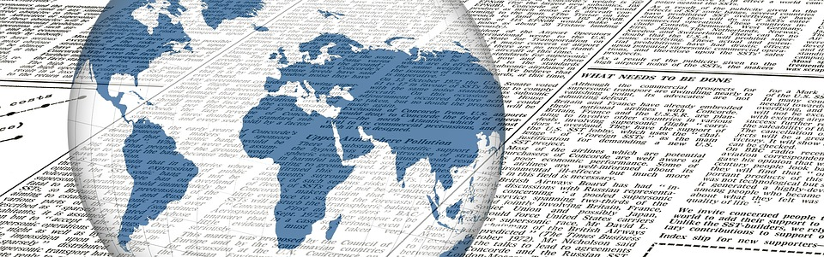
Media Modeling: journalism data collection and analysis
MD Shuey, 2019

Slide 2
Project inception
Manual Collection
(daily)
Former internship project
E-mail newsletter summarizing relevant news across 7 major English-language sources
Originally Excel analysis, later reconstructed via R
Manual Classification
Few, Select Sources

Slide 3
How to recreate? How to expand?
Manual Collection
(daily)
Automatic API Collection
Automatic headline pulling
Manual classification
Sentiment analysis
Manual Classification
ML Classification text analysis
Select Sources
Any/All Sources!

Slide 4
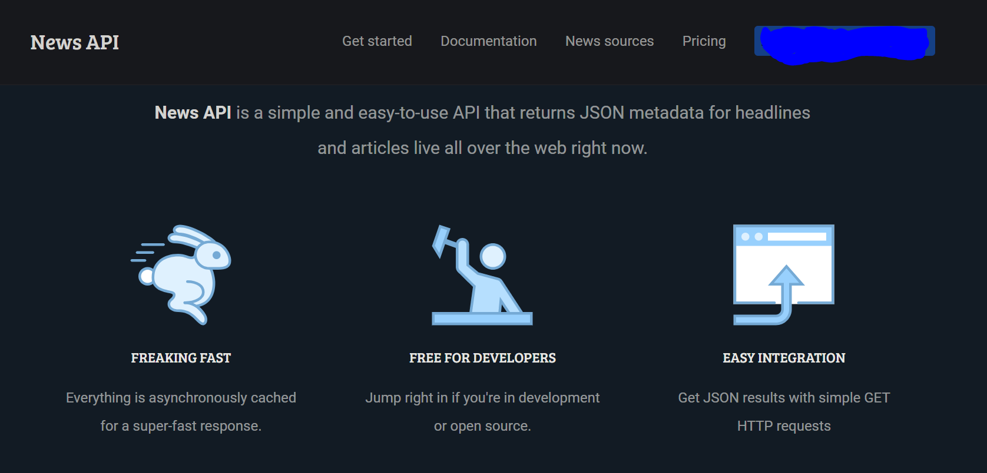
NEwsapi

Slide 5
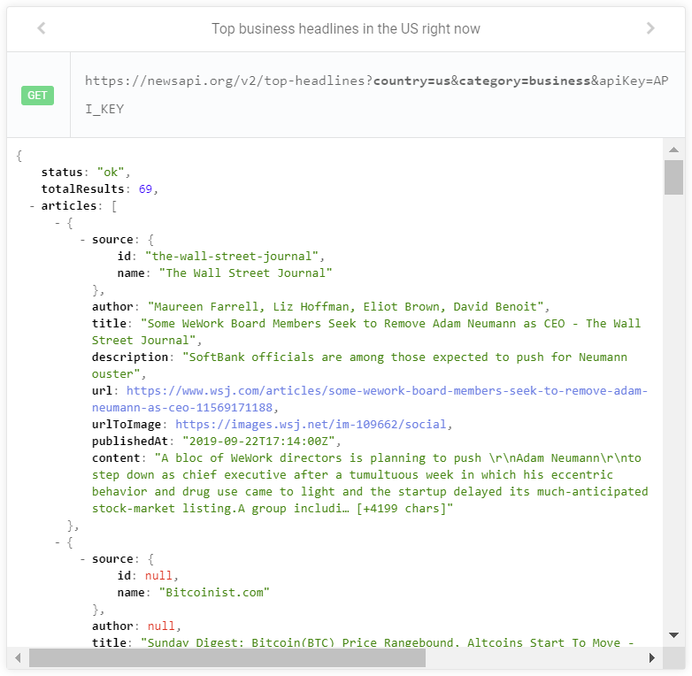
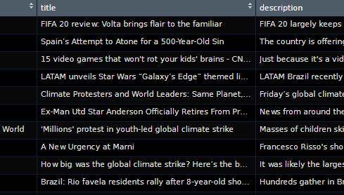
NEWSAPI R wrapper
Github.com/MDshuey/NewsAPI
  Credit to mkearney for 1.0
  Possible future pull request for 2.0 updates
Using R parameters, creates the HTML API call, and converts from JSON to data frame format
daily_recaps loop function allows for more efficient pulling (from the last 31 days)
Variables:
  Source, author, title, URL, image URL, time published, content (first sentences of article)

Slide 6
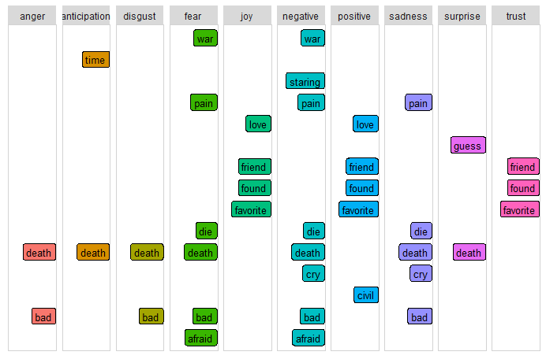
Use cases
Customized news alerts
Time series event detection
Determine news cycle beginning, peak, end
  From this, predict article popularity
Sentiment analysis of text from difference sources
  Compare popularity to positivity/negativity index
  sentiment dictionary matrix (lexicon)

Slide 7
conclusion
GitHub.com/Mdshuey/Portfolio
LinkedIn: Mitchell D. Shuey
Open to career opportunities!

